Slide 1
Cosc 4735
Flutter
sensors

Slide 2
Stream
Stream A source of asynchronous data events
  A stream is like a pipe, you put a value on the one end and if there is a listener, then they will receive it.
    they can be multiple listeners, then all of them will receive the same data.
  the .listen call returns a streamSubscription object.
We can create a stream using a controller for this example
StreamController<double> controller = StreamController<double>();
Stream stream = controller.stream; //created a stream
stream.listen((value) { log('Value is: $value'); }); //async
…
controller.add(12); //the above listener will be triggered.

Slide 3
Stream (2)
We normally use a StreamBuilder in Flutter, which needs to be cancelled when the widget is removed.
The subscriptionObject can also be used to unsubscribe from the events, or to temporarily pause the events from the stream.
controller.cancel() will remove the listener.
  its good practice to make sure you unsubscribe.
  You can get an error for subscribing when you have already subscribed.
Besides the sensors, networking is almost all streams as well.

Slide 4
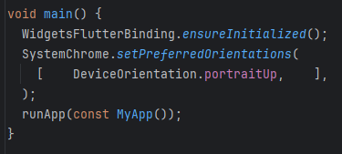
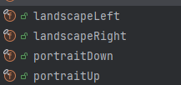
Locking Screen Orientation
When we are moving the phone around to check the sensors, likely a good time to think about locking the screen orientation.
import 'package:flutter/services.dart';
give it an array of preferred, in our case, just portraitUp.

Slide 5
initState() and dispose()
If a State's build method depends on an object that can itself change state, for example a ChangeNotifier or Stream, or some other object to which one can subscribe to receive notifications, then be sure to subscribe and unsubscribe properly in initState, didUpdateWidget, and dispose.
@override void initState() {} //called at the start of app widget
@override void dispose() {} //when the widget is being destroyed.

Slide 6
Sensors
devices sensors Accelerometer, gyroscope, magnetometer, barometer, and battery.
note, may not makes sense on some platforms.

Slide 7
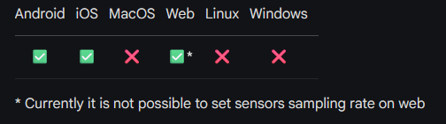
Sensors
We have access to via sensors_plus
  Accelerometer and userAccelerometer
  Gyrosope
  Magnetometer
  and battery information.
Accessing the sensors is straight forward
  We initiate listeners for each sensor that we want. Then the listener uses the setState to change values in our application.
https://www.youtube.com/watch?v=Fq5zNPJufD0 sensors_plus package of week. See iOS note as well.

Slide 8
Sensors
Accelerometer events
  event.x, event.y, event.z
    if holding the phone upright, y will be ~9.8 (gravity)
userAccelerometer events
  event.x, event.y, event.z
  same as Accelerometer but doesn't count gravity.
Gyroscope
  event.x, event.y. event.z
  represent how the orientation, ie the tilt, of phone is changing.
Magnetometer events
  event.x, event.y, event.z
  Measures the ambient geomagnetic field for all three physical axes. good for compasses.
Barometer events
  event.pressure, event.timestamp
  Measures the ambient air pressure in hPa or mbar.

Slide 9
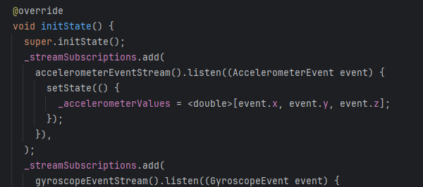
add listeners
in the initState() for the "main" widget,
  using an array StreamSubscriptions
  add each listener that we want to subscriber to and setState() causes actions.

Slide 10
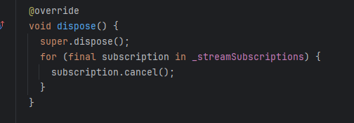
remove subscriptions
using the dispose() method cancel each subscription.

Slide 11
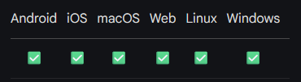
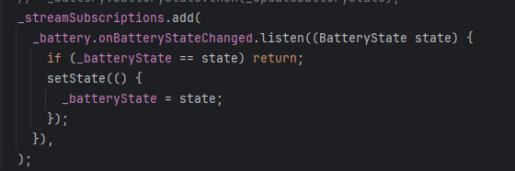
battery_plus 7.0.0
battery state, charging or not charging from the listener.
We can also get addition information
  first get an instance of the battery.
  var battery = Battery();
  var batteryLevel = await _battery.batteryLevel; //for the battery level
    ie 70% left,

Slide 12
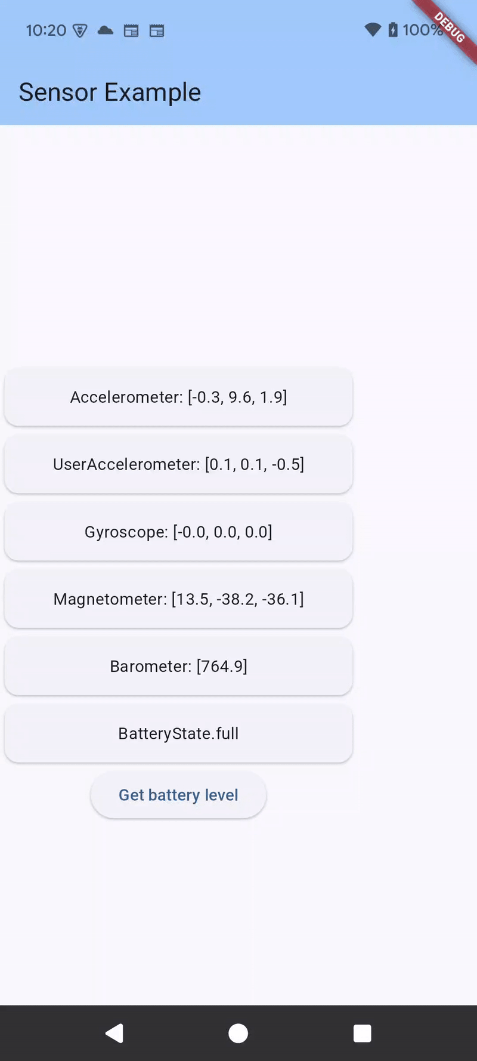
Finally
Now what?
What you do with the information is up to you.
You can make games based on tilt of the phone
compass from magnetometer
measure how hard you throw your phone across the room?

Slide 13
keyboard
We talk about touch/gestures in drawing lecture.

Slide 14
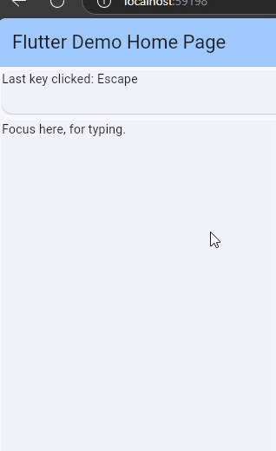
getting key "presses"
there are a couple of way to do this, but the easiest, use the Focus widget.
  onKeyEvent: (node, event) {}
  autofocus: true, (if can't get focus itself)
  focusNode: _focusNode, (again widget can't)
  child: this is widget (set of widgets) you want keystrokes from.

Slide 15

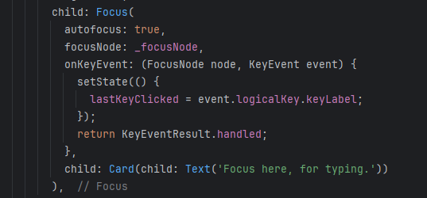
code
note
  some devices are harder to get keyboard input from then others
  e.g. android, you need to get the keyboard showing, unless you a Bluetooth device.

Slide 16
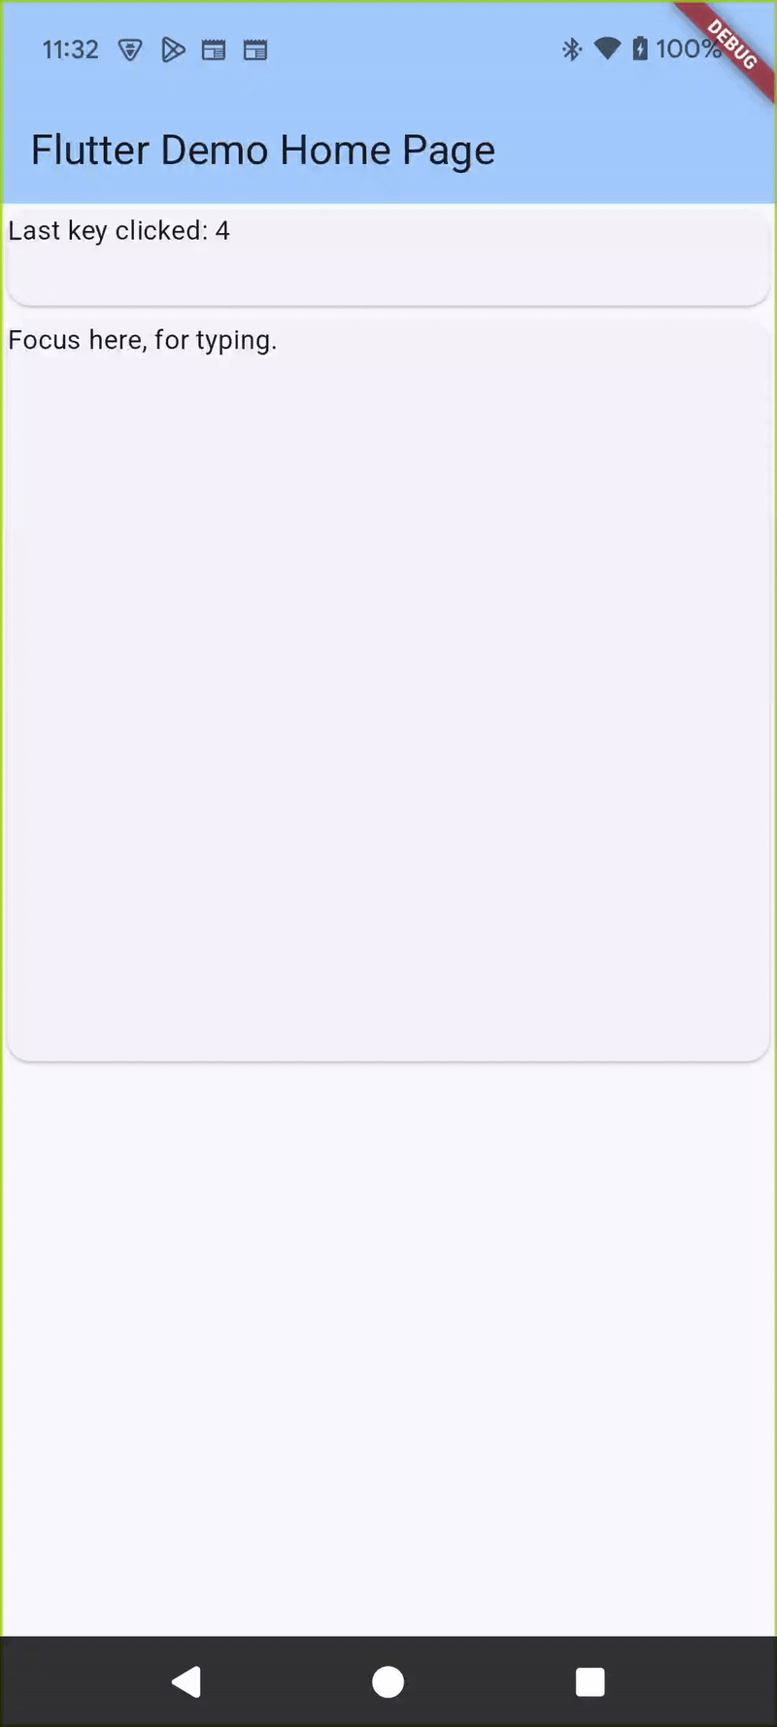
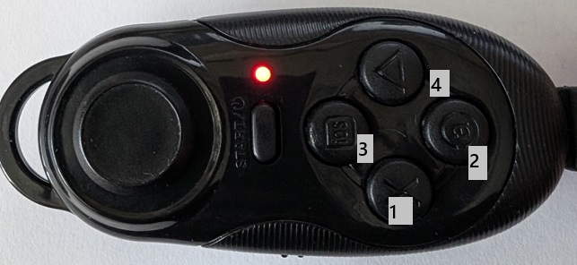
Note game devices and android.
Android treats most Bluetooth devices as version of a keyboard.
this example so works for my device

Slide 17
gamepads
game devices like controllers and Bluetooth devices

Slide 18
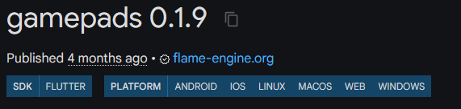
gamepads plugin
flutter doesn't currently have a native way to recognize controllers.
There is a gamepads plugin does seem to work. It's still in beta v 0.1.9 as of writing.
  for android, it requires you to add some Kotlin code to the android piece, which worked great.

Slide 19
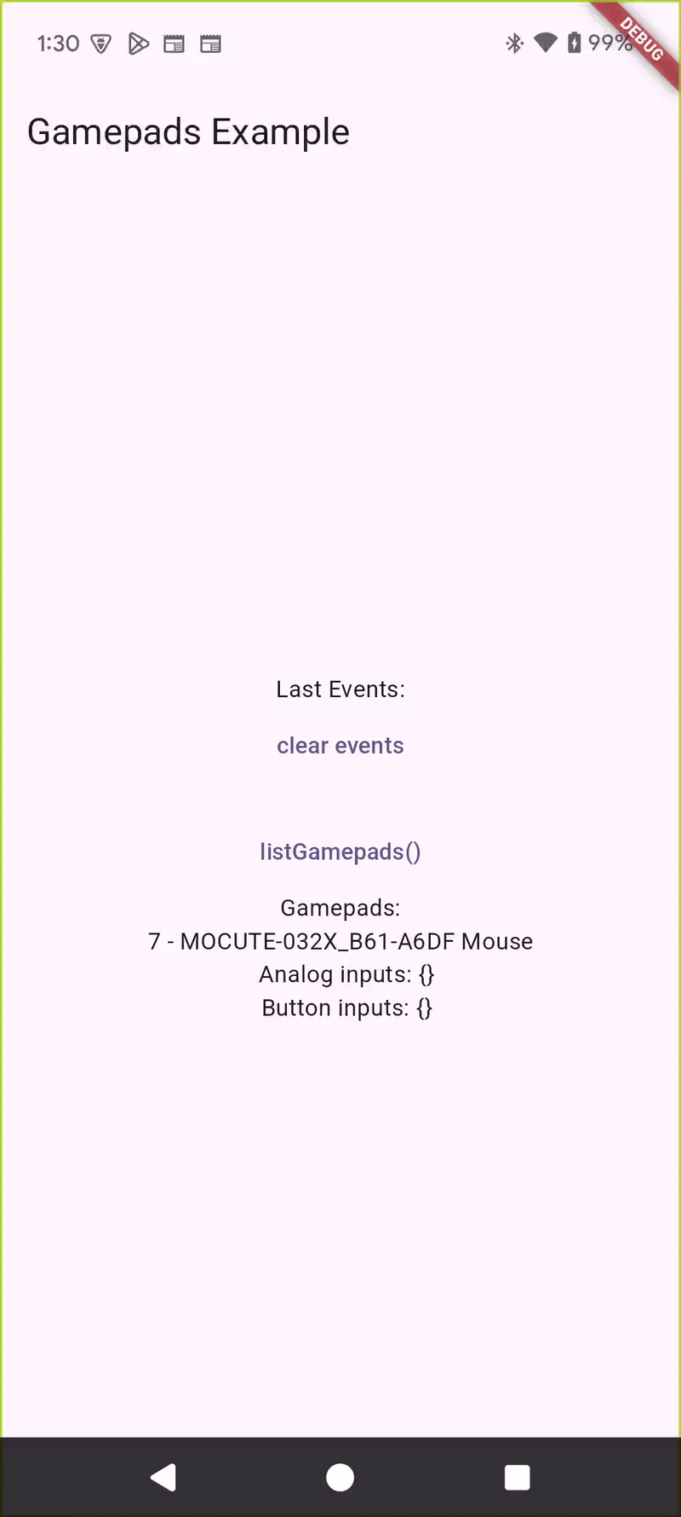
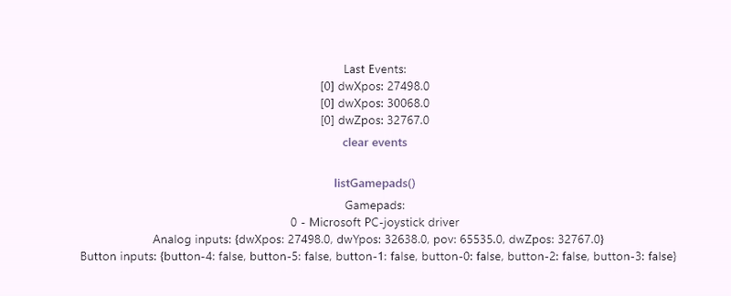
gamepads plugin
It works by using a stream listen subscription object.
  can see multiple devices
I tested their example code for android and windows11 and it worked fine.
win11 with Logitech gamepad
android with fdefairy controller

Slide 20
References
https://pub.dev/packages/sensors_plus
https://pub.dev/documentation/battery_plus
https://docs.flutter.dev/cookbook/design/orientation
https://api.flutter.dev/flutter/widgets/State/initState.html
https://api.flutter.dev/flutter/dart-async/Stream-class.html
https://medium.com/flutter-community/flutter-stream-basics-for-beginners-eda23e44e32f
https://pub.dev/packages/gamepads

Slide 21
Q
A
&

